Slide 1
How to Build an Industry Cost Profile (ICP) for a Service in UK
Select the Industry Code Based on the Supplier’s Business and Product
Step 2
Identify Data Sources for Financial and Manufacturing Information Related to Industry Code
Step 3
Use Financial Data to Calculate Ratios for COGS, PBT, GSA & Other Expenses
Step 4
Use Manufacturing Data to Calculate Ratios for DM, DL, and MOH
Step 1

Slide 2
Select the Industry Code Based on the Supplier’s Business and Product
Step 1
  The first step is to identify the appropriate industry code. The codes are classified based on a SIC code. A detailed list can be found here:
  For Facilities Management, we used: 81100 - Combined facilities support activities
 | Direct Material (DM)
 | Direct Labor (DL)
 | Manufacturing Overhead (MOH)
 | Cost of Goods Sold (COGS)
 | GSA & Other Expenses
 | Profit Before Tax (PBT)
 | Total Sales
Manufacturing data
Source: UK Office for National Statistics
  http://www.companieshouse.gov.uk/infoAndGuide/sic/sic2007.shtml
Financial data
Source: Financial reports of companies
*You will use these data sources to express DM, DL, MOH, COGS, GSA & Other Expenses and PBT as ratios, in the form of percentages of Total Sales.

Slide 3
Identify Data Sources for Financial and Manufacturing Information Related to Industry Code
Step 2
  COGS, GSA & PBT can be obtained by analysing relevant company financials
  For further breaking down COGS, we need to calculate DM, DL and OH percentages. For this, we need to obtain the industry data published by the UK Office for National Statistics.
 | Direct Material (DM)
 | Direct Labor (DL)
 | Manufacturing Overhead (MOH)
 | Cost of Goods Sold (COGS)
 | GSA & Other Expenses
 | Profit Before Tax (PBT)
 | Total Sales
Manufacturing data
Source: UK Office for National Statistics
Financial data
Source: Financial reports of companies
*You will use these data sources to express DM, DL, MOH, COGS, GSA & Other Expenses and PBT as ratios, in the form of percentages of Total Sales.

Slide 4
Use Financial Data to Calculate Ratios for COGS, PBT, GSA & Other Expenses
Step 3
  From each firms’ Income Statement, use multiple year averages to calculate COGS, GSA & Other Expenses and PBT.
  Use as many firms as you judge necessary to get an accurate representation of the industry you are modelling.
Industry Cost Profile, the UK, Average Percentage Breakdown
Category | Facilities Management/Support activities
Cost Elements | Percentages of Revenues
Direct Materials (DM) | ?
Direct Labour (DL) | ?
Overheads (OH) | ?
Cost of Goods Sold (COGS) | 78.2%
Selling, General & Administrative Expense (SG&A) | 18.3%
Profit Before Tax (PBT) | 3.5%
Revenues – Total | 100%
Note: COGS = DM+DL+OH, Revenues = COGS+SG&A+PBT

Slide 5
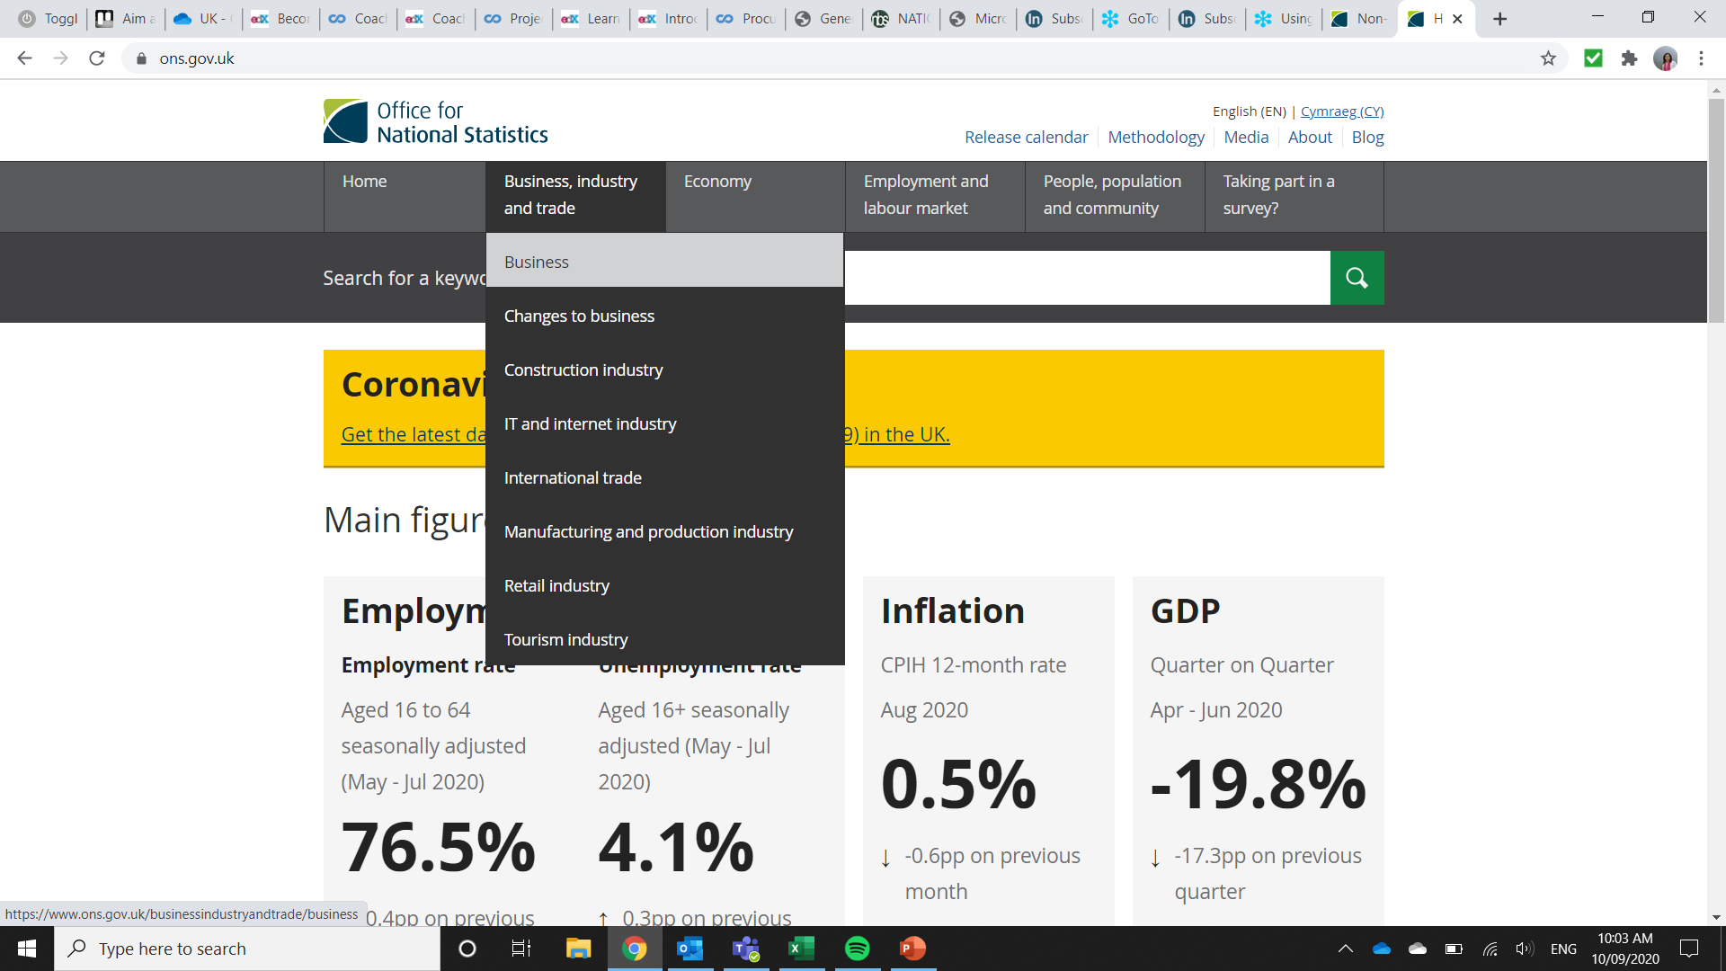
Use Manufacturing Data to Calculate Ratios for DM, DL, and MOH
Step 4
  1. Please click the following link for the National Statistics website of the UK:
  2. Click on “Business, industry and trade”. Then click on the ‘Business’
  https://www.ons.gov.uk/

Slide 6
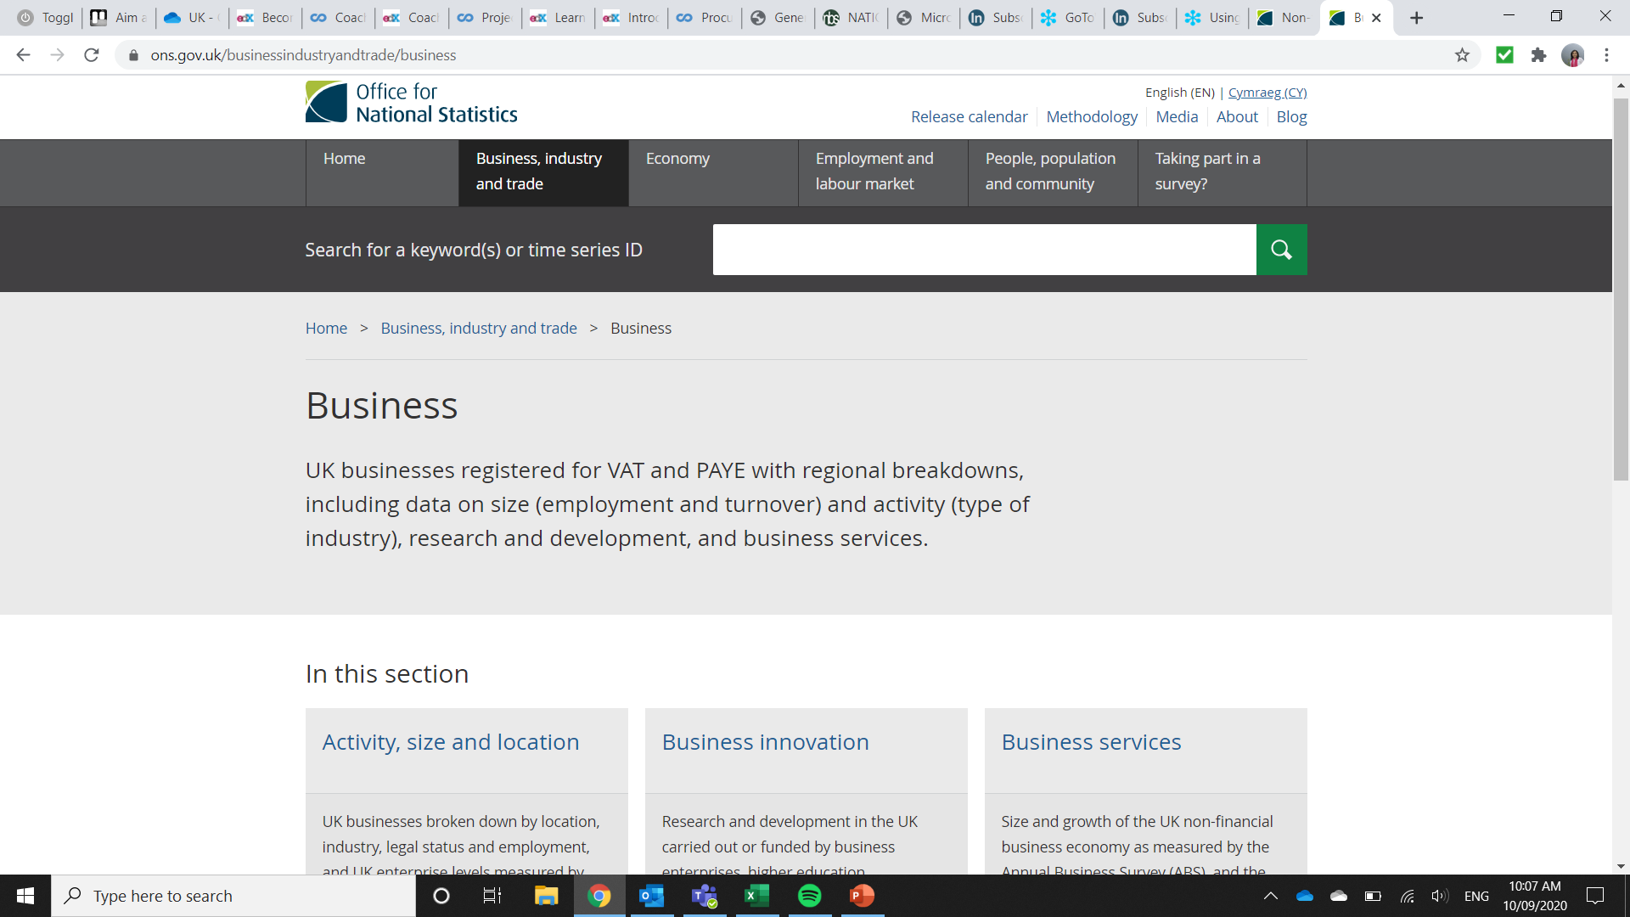
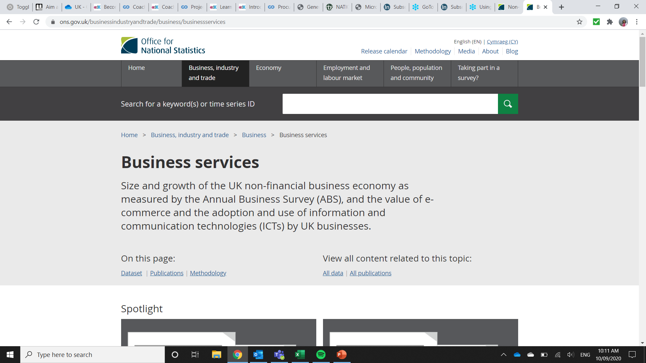
Use Manufacturing Data to Calculate Ratios for DM, DL, and MOH
Step 4
  3. Scroll down and click on “Business Services”.
  4. Click on “Dataset” under “On this page” to download dataset in excel

Slide 7
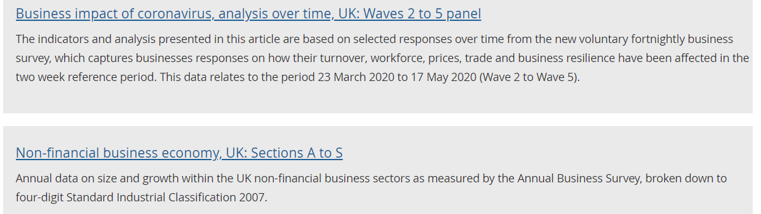
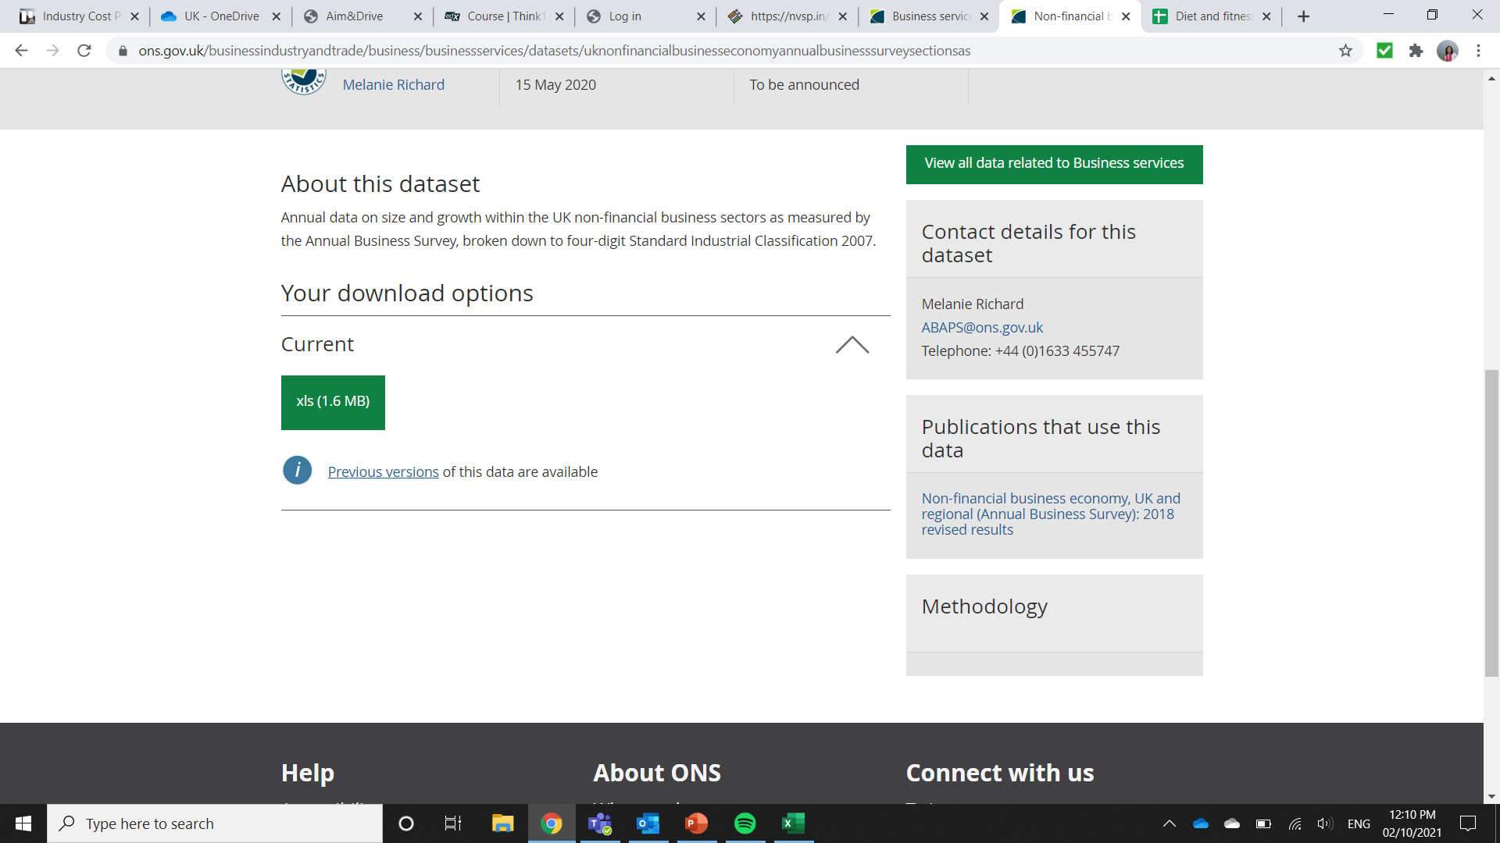
Use Manufacturing Data to Calculate Ratios for DM, DL, and MOH
Step 4
  5. Scroll down and click on “Non-financial business economy, UK: Section A to S”
  6. Click on xls file to download the dataset in excel format

Slide 8
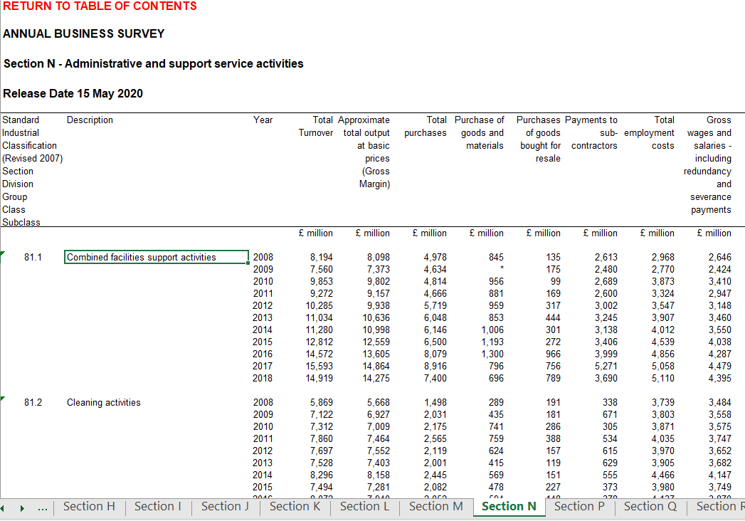
Use Manufacturing Data to Calculate Ratios for DM, DL, and MOH
Step 4
  7. Go to worksheet “Section N” , scroll down to SIC 81.1, and record the following numbers for 2015 to 2018:
  Total Turnover
  Purchase of goods and materials
  Payments to sub-contractors
  Total employment costs
  A note here is that the ‘total employment costs’ are the costs for all the personnel in the company which includes direct and indirect labour.

Slide 9
Use Manufacturing Data to Calculate Ratios for DM, DL, and MOH
Step 4
  8. Summarize the data obtained for all years of interest.
ICP, Breakdown of Industry Data
Cost Elements (in GBP Million) | 2015 | 2016 | 2017 | 2018
Total Turnover (Revenue) | 12,812 | 14,572 | 15,593 | 14,919
Purchase of goods and materials | 1,193 | 1,300 | 796 | 696
Payments to sub-contractors | 3,406 | 3,999 | 5,271 | 3,690
Total employment costs | 4,539 | 4,856 | 5,058 | 5,110

Slide 10

Use Manufacturing Data to Calculate Ratios for DM, DL, and MOH
Step 4
  Calculate average percentages of cost elements:
  1. DM = Purchase of goods and materials/Revenue
  2. DL = Calculated Direct Labour/Revenue
  3. The Overheads can be used as a balancing figure. OH% = COGS% - DM% - DL%
ICP, Percentage Breakdown of Industry Data
Cost Elements | 2015 | 2016 | 2017 | 2018 | Average
Purchase of goods and materials (DM) | 9.31% | 8.92% | 5.10% | 4.67% | 7.00%
Payments to sub-contractors | 26.58% | 27.44% | 33.80% | 24.73% | 28.14%
Total employment costs | 35.43% | 33.32% | 32.44% | 34.25% | 33.86%
Direct Labor (DL) | 51.38% | 50.77% | 56.51% | 48.71% | 51.84%
Note: Direct Labor is assumed as the sum of ‘Payments to sub-contractors’ and 70% of ‘Total Employment Costs’

Slide 11
Present all your calculated ratios in the cost breakdown format
ICP, Percentage Breakdown, the UK, Facilities Management Category
 | Direct Material (DM) | 7.00%
 | Direct Labor (DL) | 51.84%
 | Overhead (OH) | 19.36%
 | Cost of Goods Sold (COGS) | 78.20%
 | GSA & Other Expenses | 18.30%
 | Profit Before Tax (PBT) | 3.50%
 | Total Sales | 100.00%
Manufacturing data
Source: UK Office for National Statistics
Financial data
Source: Financial reports of companies

